Slide 1

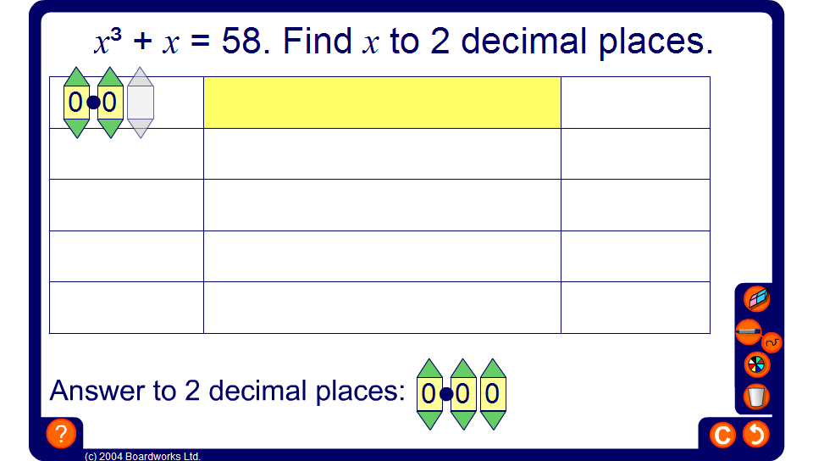


Using trial and improvement

